Slide 1

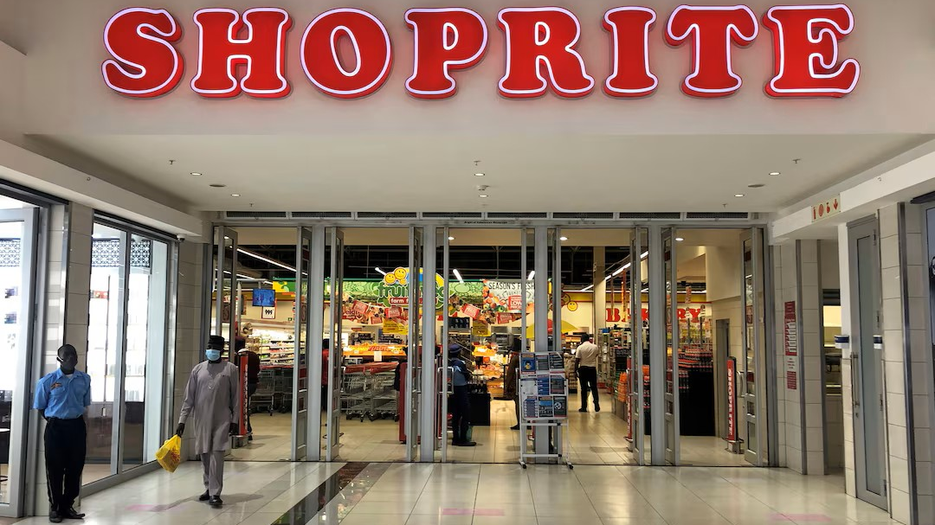

Shoprite Group Financial Analysis
By Caroline N. Keli

Slide 2
Executive Summary - Shoprite Financial Statement Analysis FY2025
Strategic Overview
This report analyses and evaluates Shoprite Holdings' profitability, liquidity, and financial stability.
Strong financial performance
Revenue increased 8.6% to R256.7bn, while trading profit increased 16.6% and net profit increased 21%.
Improved operating leverage
Operating expenses grew more slowly than revenue, supporting stronger operating profitability.
Stable gross margin
Gross margin remained approximately 24%, indicating broadly stable gross profitability.
Liquidity has weakened
Current ratio remained above 1.0x, but quick ratio declined from 0.46x to 0.35x, while cash relative to current liabilities fell.
Management focus
The key area to monitor is the balance between continued growth and working-capital/liquidity management, particularly inventory and short-term obligations.

Slide 3


Profit & Loss Analysis
P&L Performance
Revenue Growth: Group revenue increased by 8.6%, from R236.3bn in 2024 to R256.7bn in 2025, driven primarily by growth in merchandise sales.
Gross Profitability: Gross profit increased to R61.4bn, while the gross profit margin remained stable at 24%, indicating that gross profitability was maintained despite the increase in sales.
Operating Performance: Trading profit increased by 16.6% to R15.0bn, while operating profit increased by 18% to R14.9bn, reflecting stronger operating profitability.
Cost Management: Cost of sales increased by 8.3%, broadly in line with revenue growth, while operating expenses increased by approximately 7%. The slower growth in operating expenses relative to revenue supported the improvement in operating profitability.
Bottom Line: Net profit increased by 21% to R7.6bn, demonstrating stronger overall profitability during the year.
Shoprite Holdings Annual Financial Statement Report 2025, Consolidated Statement of Comprehensive Income; calculations by author.

Slide 4
Operational Profitability
Metric Assessed | FY 2024 | FY 2025 | YoY Change / Significance
Group Revenue | R 236,328 M | R 256,682 M | ▲8.6% merchandise sales remained the primary revenue driver.
Group Profit Margin | 24% | 24% | ▲ to 61.4 bn, Gross Profit Margin remained stable at 24%.
Operating expenses | R 46,961 M | R 50,472 M | ▲7.0% expense growth remained below revenue growth.
Trading Profit | R 12,818 M | R 14,951 M | ▲16.6% Profit growth outpaced revenue growth.
Net Profit | R 6,221 M | R 7,583 M | ▲21% bottom-line translation increase.

Slide 5
KPI Dashboard
Shoprite Holdings Annual Financial Statement Report 2025, Consolidated Statement of Comprehensive Income; calculations by author.

Slide 6
Profit & Loss Summary
Shoprite Holdings Integrated Annual Report 2025, Consolidated Statement of Comprehensive Income; calculations by author.

Slide 7

Balance Sheet & Working Capital Analysis
Asset & Liability Composition: The balance sheet remains heavily concentrated in right-of-use assets, inventory and property, plant and equipment, which together represent a significant proportion of total assets. On the liabilities side, lease liabilities and trade & other payables remain the major components, reflecting the Group’s capital and operating structure.
Liquidity Position: Liquidity remained positive but weakened modestly during 2025. The current ratio declined from 1.21x to 1.19x, while the quick ratio fell from 0.46x to 0.35x. Cash relative to current liabilities also declined from 28% to 22%, indicating a reduced immediate cash cushion for meeting short-term obligations.
Leverage: Financial leverage increased modestly during the year. The total liabilities-to-equity ratio increased from 3.05x to 3.15x, while financial leverage increased from 4.05x to 4.15x. This indicates a slight increase in the proportion of the Group's assets and liabilities relative to shareholders' equity.
Source: Shoprite Holdings Annual Financial Statement 2025, Consolidated Statement of Financial Position; calculations by author.

Slide 8
Balance Sheet & Working Capital Analysis Continued
Working Capital Efficiency
Receivables: Receivables turnover remained broadly stable at approximately 73x, with DSO remaining at around 5 days in both 2024 and 2025. This indicates a consistently short collection cycle, consistent with the nature of Shoprite's retail operations.
Inventory: DIO declined from 58.64 days to 56.77 days, indicating that inventory was held for a slightly shorter period in 2025. Inventory nevertheless remained a significant component of the asset base, representing approximately 24% of total assets. Continued monitoring of inventory turnover and stock levels is therefore important to working-capital management.
Payables: DPO increased from 61.94 days to 65.05 days, while AP turnover declined from 5.89x to 5.61x. The longer payment cycle may support cash retention within the business, although it should be considered alongside supplier relationships and contractual payment terms.
Shoprite Holdings Annual Financial Statement Report 2025, Note 15 — Trade and Other Receivables; calculations by author.

Slide 9
Ratio Analysis
Ratios | 2025 | 2024 | Change | Interpretation
Current Ratio | 1.19x | 1.21x | ▼ 0.02x | Relatively stable current-asset coverage
Quick Ratio | 0.35x | 0.46x | ▼ 0.11x | Greater reliance on inventory/operating cash flows
Cash / Current Liabilities | 22% | 28% | ▼ 6% | Reduced immediate cash cushion
Inventory / Total Assets | 24% | 25% | ▼ 1% | Inventory remains a significant asset component
Total Liabilities / Equity | 3.15x | 3.05x |  | Increased leverage
Financial Leverage | 4.15x | 4.05x | ▲ 0.10x | Slight increase in assets relative to equity
Working Capital | R8,326m | R8,521m | ▼ 2.3% | Positive but slightly reduced liquidity buffer
AR Turnover | 73.21x | 73.39x | ▼0.18 | Receivables turnover remained broadly stable
DSO | 4.99 days | 4.97 days | ▲ 0.02 days | Receivables turnover was essentially stable year-on-year
DIO | 56.77 days | 58.64 days | ▼1.87 days | inventory was held for a slightly shorter period in 2025.
DPO | 65.05 days | 61.94 days | ▲ 3.11 days | Longer supplier payment cycle
Cash Conversion Cycle | -3.29 days | 1.28 days | ▼-2.01 days | Shorter inventory holding period and longer supplier payment period relative to the collection cycle.
Source: Shoprite Holdings Annual Financial Statement Report 2025, Consolidated Statement of Financial Position; calculations by author.

Slide 10

Cash Flow Statement Analysis
Operating cash flow declined by approximately 21% from R13.8bn in 2024 vs R10.98bn in 2025.
Cash Flow Analysis
Operating Cash Generation▼
R10.98bn in 2025 vs R13.84bn in 2024 ▼ 20.6%
Operating cash generation weakened despite higher reported profitability, indicating lower cash conversion from operating activities.
Cash Conversion ▼
Operating cash flows / Net Income: 1.47x vs 2.59x
Operating cash flow remained above net income, but the significant decline indicates weaker conversion of earnings into cash.
Free Cash Flow ▼
R3.0bn vs R6.1bn ▼ 51%
The Group remained free-cash-flow positive, but significantly less cash remained after capital expenditure.
Closing Cash ▼
R9.3bn vs R10.0bn▼ 7.1%
Year-end cash reserves declined despite positive operating cash generation.
Shoprite Holdings Annual Financial Statement Report 2025, Consolidated Statement of Cash Flows; calculations by author.

Slide 11
Strategic Recommendations
Strengthen Inventory Management: Monitor inventory days and turnover by category to identify slow-moving or excess inventory and reduce cash tied up in working capital.
Protect short-term liquidity: Monitor the growth and composition of current liabilities and assess opportunities to reduce reliance on short-term financing while maintaining adequate liquidity.
Strengthen cash-based decision-making: Align capital expenditure and other discretionary spending with cash-generation capacity to preserve liquidity while supporting strategic growth.
Shoprite remained cash-generative in 2025; however, weaker operating cash generation and lower free cash flow reduced the Group's cash position. Management should continue monitoring operating cash conversion and working-capital movements while maintaining investment in the business.

Slide 12
Limitations to the Analysis
The analysis is based primarily on publicly available annual financial information and therefore does not include monthly or internal management reporting data.
Budget and forecast information was not available, limiting forward-looking variance analysis.

Slide 13
Sources & Methodology
Primary Source
Shoprite Holdings Limited. (2025) Annual Financial Statements 2025.
Financial statements for the year ended 29 June 2025.
Link: https://www.shopriteholdings.co.za/docs/shp-afs-2025.pdf
Analysis & Calculations
Financial ratios, horizontal and vertical analyses, working-capital metrics, and cash conversion cycle calculations were prepared by the author using figures reported in the 2025 and 2024 financial statements.
Methodology Note
Unless otherwise stated, ratio calculations use year-end balances. Days-based ratios are calculated using a 365-day year. The analysis is based on publicly available financial information and does not include internal management accounts, budgets or forecasts.
Tools
Microsoft Excel: financial analysis and calculations
Microsoft PowerPoint: presentation and visualization

